Slide 1
Deep Learning

Slide 2
Outlie
What is deep learning
How to conduct deep learning
Why deep learning

Slide 3
“Deep Learning doesn’t do different things, it does things differently”

Slide 4
Ups and downs of Deep Learning
1958: Perceptron (linear model)
1969: Perceptron has limitation
1980s: Multi-layer perceptron
Do not have significant difference from DNN today
1986: Backpropagation
Usually more than 3 hidden layers is not helpful
1989: 1 hidden layer is “good enough”, why deep?
2006: Restricted Boltzmann Machine (RBM) initialization
2009: GPU
2011: Start to be popular in speech recognition
2012: win ILSVRC image competition
2015: Image recognition surpassing human-level performance
2016: Alpha GO beats Lee Sedol
2016: Speech recognition system as good as humans
2019: Turing Award recipient: Yoshua Bengio, Geoffrey Hinton, and Yann Lecun
Notes:
They were popularised by Frank Rosenblatt in the early 1960’s.
In 1969, MIT ＭArvin Minsky and Papert published a book called “Perceptrons” that analysed what they could do and showed their limitations.
The backpropagation algorithm was originally introduced in the 1970s, but its importance wasn't fully appreciated until a famous 1986 paper by David Rumelhart, Geoffrey Hinton, and Ronald Williams.
During the 1950s and ’60s, neural networks were in vogue among computer scientists. In 1958, Cornell research psychologist Frank Rosenblatt, in a Navy-backed project, built a prototype neural net, which he called the Perceptron, at a lab in Buffalo. It used a punch-card computer that filled an entire room. After 50 trials it learned to distinguish between cards marked on the left and cards marked on the right. Reporting on the event, the New York Times wrote, “The Navy revealed the embryo of an electronic computer today that it expects will be able to walk, talk, see, write, reproduce itself and be conscious of its existence.”
One of the first versions of the theorem was proved by George Cybenko in 1989 for sigmoid activation functions
1989: http://deeplearning.cs.cmu.edu/notes/Sonia_Hornik.pdf
George Cybenko is the Dorothy and Walter Gramm Professor of Engineering at Dartmouth and a fellow of the IEEE
Speech: begin 2009
2012: Times

Slide 5
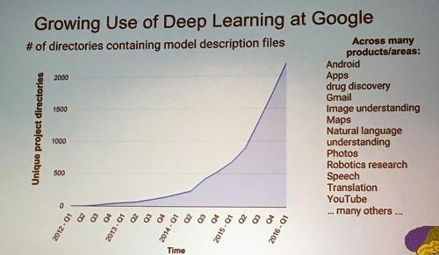
Deep learning attracts lots of attention.
I believe you have seen lots of exciting results before.
Deep learning trends at Google. Source: SIGMOD 2016/Jeff Dean

Slide 6

Supervised Learning
Traditional pattern recognition models work with hand crafted features and relatively simple trainable classifiers.
Limitations
Very tedious and costly to develop hand crafted features.
The hand-crafted features are usually highly dependents on one application.
Trainable Classifier
(e.g. SVM, Random Forrest)
Extract Hand Crafted Features
Output
(e.g. Outdoor Yes or No)

Slide 7


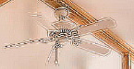

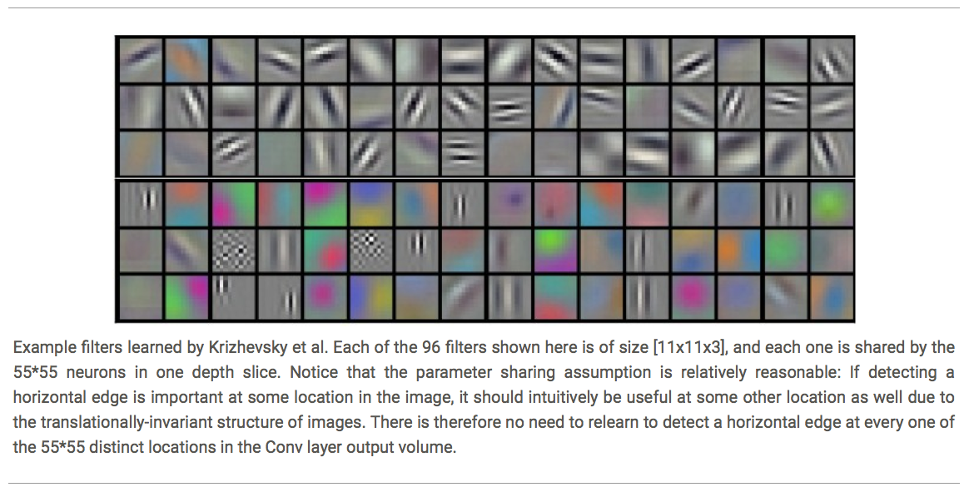
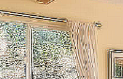



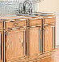






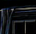

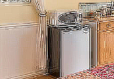
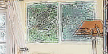
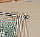
Deep Learning
Deep learning has an inbuilt automatic multi stage feature learning process that learns rich hierarchical representations (i.e. features).
Low Level Features
Mid Level Features
High Level Features
Trainable Classifier
Output
(e.g. outdoor, indoor)

Slide 8
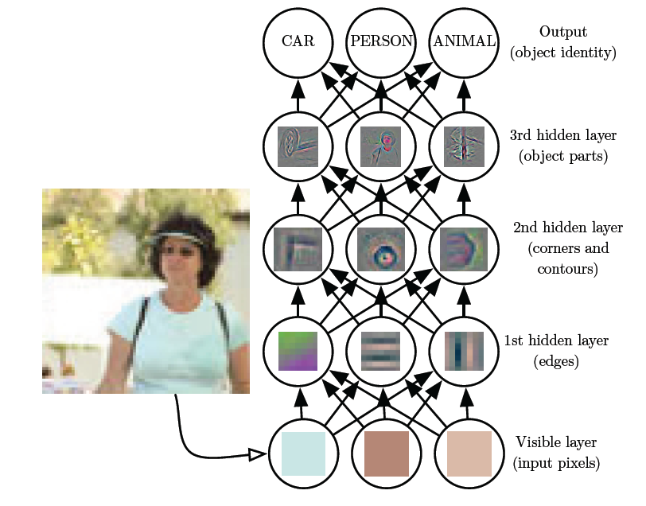
Deep Learning

Slide 9
Deep learning techniques
Supervised deep learning
Unsupervised deep learning
Semi-supervised deep learning
Transfer deep learning
…..
Notes:
http://www.twword.com/wiki/%E8%85%A6%E6%88%B6%E7%A9%B4
http://ukenglish.pixnet.net/blog/post/105691160-%E3%80%90%E5%8F%B0%E5%8D%97%E5%B8%82%E5%AD%B8%E8%8B%B1%E8%AA%9E%EF%BC%8C%E5%84%AA%E9%85%B7%E8%8B%B1%E8%AA%9E%E6%96%87%E7%90%86%E5%85%AC%E5%91%8A%E3%80%91%E6%9C%AC%E4%B8%AD%E5%BF%83
http://onepiece1234567890.blogspot.tw/2013/12/blog-post_8.html

Slide 10
Three Steps for Deep Learning Training
Step 1: define a set of function
Step 2: goodness of function
Step 3: pick the best function
Neural
Network
Notes:
http://www.twword.com/wiki/%E8%85%A6%E6%88%B6%E7%A9%B4
http://ukenglish.pixnet.net/blog/post/105691160-%E3%80%90%E5%8F%B0%E5%8D%97%E5%B8%82%E5%AD%B8%E8%8B%B1%E8%AA%9E%EF%BC%8C%E5%84%AA%E9%85%B7%E8%8B%B1%E8%AA%9E%E6%96%87%E7%90%86%E5%85%AC%E5%91%8A%E3%80%91%E6%9C%AC%E4%B8%AD%E5%BF%83
http://onepiece1234567890.blogspot.tw/2013/12/blog-post_8.html

Slide 11
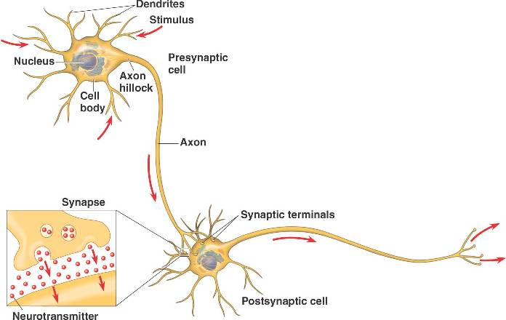
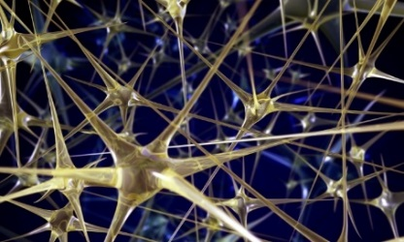
Neural Network
“Neuron”
Neural Network
Different connection leads to different network structures
Network parameter $θ$: all the weights and biases in the “neurons”

Slide 12
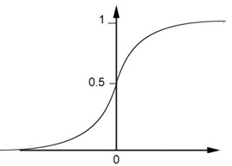
Fully Connect Feedforward Network
1
4
0.98
1
-2
1
-1
-2
0.12
-1
1
0
Sigmoid Function
Notes:
Ignore +

Slide 13
Fully Connect Feedforward Network
1
4
0.98
2
0.86
3
0.62
1
-2
-1
-1
1
0
-2
-1
-2
0.12
-2
0.11
-1
0.83
-1
1
-1
4
0
0
2

Slide 14
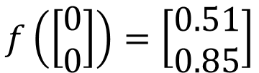
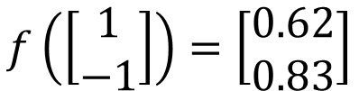
Fully Connect Feedforward Network
1
0.73
2
0.72
3
0.51
0
-2
-1
-1
1
0
-2
-1
0.5
-2
0.12
-1
0.85
0
1
-1
4
0
0
2
This is a function.
$$f\left(\left[\begin{matrix}1 \\ −1\end{matrix}\right]\right)=\left[\begin{matrix}0.62 \\ 0.83\end{matrix}\right]$$
$$f\left(\left[\begin{matrix}0 \\ 0\end{matrix}\right]\right)=\left[\begin{matrix}0.51 \\ 0.85\end{matrix}\right]$$
Input vector, output vector
Given network structure, define a function set
Notes:
For example, if we modify “1” to “2”, then we have another function

Slide 15
Fully Connect Feedforward Network
neuron
Input
Layer 1
Layer 2
Layer L
Output
……
y₁
……
y₂
……
……
……
……
……
……
y_{M}
Input Layer
Output Layer
Hidden Layers
Notes:
You can connect the neurons by other ways you like ☺
How many layer is deep?
CNN just another way to connect the neuros.
You can always connect the neurons in your own way.
“+” is ignored
Each dimension corresponds to a digit (10 dimension is needed)

Slide 16
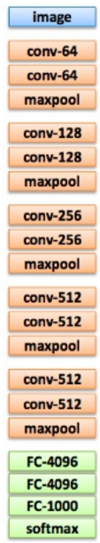
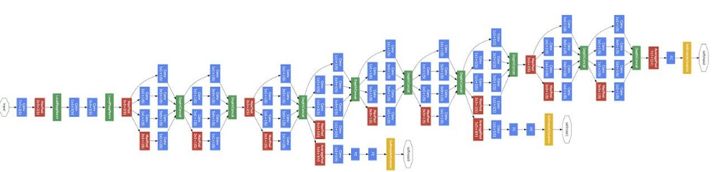
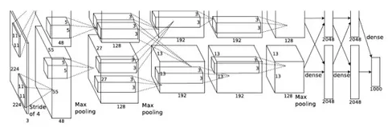
Deep = Many hidden layers
22 layers
http://cs231n.stanford.edu/slides/winter1516_lecture8.pdf
19 layers
8 layers
6.7%
7.3%
16.4%
AlexNet (2012)
VGG (2014)
GoogleNet (2014)

Slide 17
Deep = Many hidden layers
152 layers
Special
structure
Ref: https://www.youtube.com/watch?v=dxB6299gpvI
3.57%
7.3%
6.7%
16.4%
AlexNet (2012)
VGG
(2014)
GoogleNet
(2014)
Residual Net
(2015)

Slide 18
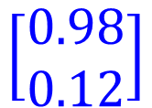
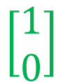
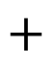
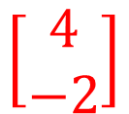
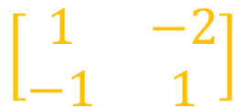
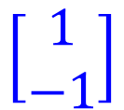

Matrix Operation
1
4
0.98
1
-2
1
-1
-2
0.12
-1
1
0
$$\left[\begin{matrix}1 & −2 \\ −1 & 1\end{matrix}\right]$$
$$\left[\begin{matrix}1 \\ −1\end{matrix}\right]$$
$$\left[\begin{matrix}1 \\ 0\end{matrix}\right]$$
$$=$$
$$\left[\begin{matrix}0.98 \\ 0.12\end{matrix}\right]$$
$$σ\left( \right)$$
$$+$$
$$\left[\begin{matrix}4 \\ −2\end{matrix}\right]$$
Notes:
Make sure you know how to do it
author: Adam Coates, Baidu, Inc.
Deep Learning (hopefully faster)
http://videolectures.net/deeplearning2015_coates_deep_learning/

Slide 19
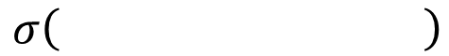
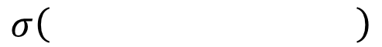
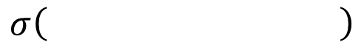
Neural Network
……
y₁
W¹
W²
W^{L}
……
y₂
b¹
b²
b^{L}
……
……
……
……
……
x
a¹
a²
y
……
y_{M}
W¹
x
b¹
+
$$σ\left( \right)$$
a¹
b²
W²
+
$$σ\left( \right)$$
W^{L}
b^{L}
a^{L-1}
+
$$σ\left( \right)$$
Notes:
Draw it?

Slide 20
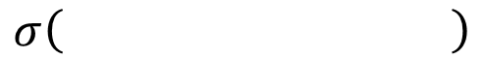
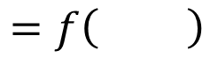
Neural Network
……
y₁
W¹
W²
W^{L}
……
y₂
b¹
b²
b^{L}
……
……
……
……
……
x
a¹
a²
y
……
y_{M}
y
x
Using parallel computing techniques to speed up matrix operation
$$=f\left( \right)$$
W^{L}
…
W²
W¹
x
b¹
b²
…
b^{L}
+
+
+
$$σ\left( \right)$$
$$=σ\left( \right)$$
$$σ\left( \right)$$
Notes:
Draw it?

Slide 21
Output Layer as Multi-Class Classifier
Feature extractor replacing feature engineering
……
y₁
……
y₂
Softmax
……
……
……
……
……
……
y_{M}
Input Layer
Output Layer
= Multi-class Classifier
Hidden Layers

Slide 22
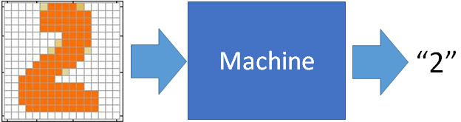
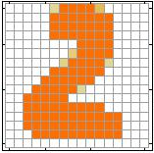
Example Application
Input
Output
y₁
is 1
0.1
y₂
is 2
0.7
The image is “2”
……
……
……
y₁₀
0.2
is 0
16 x 16 = 256
Ink → 1
No ink → 0
Each dimension represents the confidence of a digit.
Notes:
The same for even more complex tasks.

Slide 23
Example Application
Handwriting Digit Recognition
y₁
is 1
Machine
y₂
is 2
Neural
Network
“2”
……
……
……
y₁₀
is 0
What is needed is a function ……
Input:
256-dim vector
output:
10-dim vector
Notes:
The same approach for other cases

Slide 24
Example Application
Input
Layer 1
Layer 2
Layer L
Output
……
y₁
is 1
……
A function set containing the candidates for
Handwriting Digit Recognition
y₂
is 2
“2”
……
……
……
……
……
……
……
y₁₀
is 0
Input Layer
Output Layer
Hidden Layers
You need to decide the network structure to let a good function in your function set.
Notes:
CNN just another way to connect the neuros.
You can always connect the neurons in your own way.
“+” is ignored
Each dimension corresponds to a digit (10 dimension is needed)

Slide 25
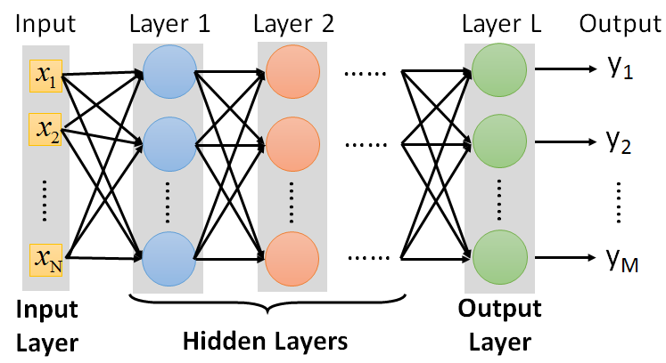
FAQ
Q: How many layers? How many neurons for each layer?
Q: Can the structure be automatically determined?
E.g. Evolutionary Artificial Neural Networks
Q: Can we design the network structure?
Trial and Error
+
Intuition
Convolutional Neural Network (CNN)

Slide 26
Three Steps for Deep Learning
Step 1: define a set of function
Step 2: goodness of function
Step 3: pick the best function
Neural
Network
Notes:
http://www.twword.com/wiki/%E8%85%A6%E6%88%B6%E7%A9%B4
http://ukenglish.pixnet.net/blog/post/105691160-%E3%80%90%E5%8F%B0%E5%8D%97%E5%B8%82%E5%AD%B8%E8%8B%B1%E8%AA%9E%EF%BC%8C%E5%84%AA%E9%85%B7%E8%8B%B1%E8%AA%9E%E6%96%87%E7%90%86%E5%85%AC%E5%91%8A%E3%80%91%E6%9C%AC%E4%B8%AD%E5%BF%83
http://onepiece1234567890.blogspot.tw/2013/12/blog-post_8.html

Slide 27

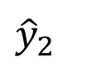
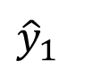
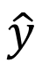
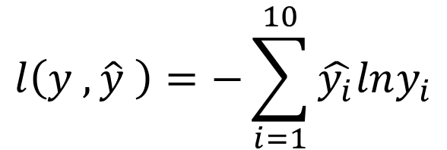
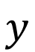
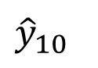
Loss for an Example
target
“1”
……
y₁
$${\hat{y}}_{1}$$
1
……
0
Given a set of parameters
y₂
$${\hat{y}}_{2}$$
Softmax
……
……
……
……
Cross
Entropy
……
……
……
y₁₀
0
$${\hat{y}}_{10}$$
$$y$$
$$\hat{y}$$
$$l\left(y ,\hat{y} \right)=−\sum_{i=1}^{10}{\hat{y_{i}}lny_{i}}$$
Notes:
https://www.youtube.com/watch?v=XWTfgehRxzU
You can never tind this in the textbook!
With softmax, the summation of all the ouputs would be one.
Can be considered as probability if you want ……

Slide 28


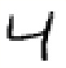
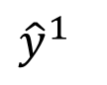
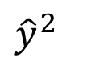
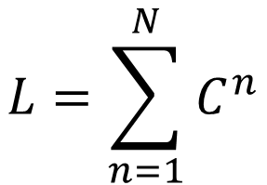
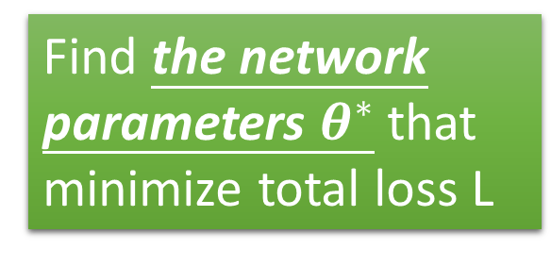
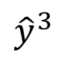
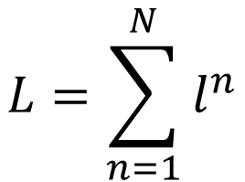
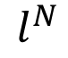
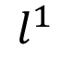
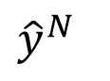
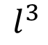
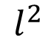
Total Loss
Total Loss:
$$L=\sum_{n=1}^{N}{l^{n}}$$
For all training data …
x¹
NN
y¹
$${\hat{y}}^{1}$$
$$l^{1}$$
NN
Find a function in function set that minimizes total loss L
x²
y²
$${\hat{y}}^{2}$$
$$l^{2}$$
x³
NN
y³
$${\hat{y}}^{3}$$
$$l^{3}$$
……
……
……
……
Find the network parameters $θ^{∗}$ that minimize total loss L
x^{N}
NN
y^{N}
$${\hat{y}}^{N}$$
$$l^{N}$$
Notes:
Randomly picked one
Two approaches update the parameters towards the same direction, but stochastic is faster!
Better!

Slide 29
Three Steps for Deep Learning
Step 1: define a set of function
Step 2: goodness of function
Step 3: pick the best function
Neural
Network
Notes:
http://www.twword.com/wiki/%E8%85%A6%E6%88%B6%E7%A9%B4
http://ukenglish.pixnet.net/blog/post/105691160-%E3%80%90%E5%8F%B0%E5%8D%97%E5%B8%82%E5%AD%B8%E8%8B%B1%E8%AA%9E%EF%BC%8C%E5%84%AA%E9%85%B7%E8%8B%B1%E8%AA%9E%E6%96%87%E7%90%86%E5%85%AC%E5%91%8A%E3%80%91%E6%9C%AC%E4%B8%AD%E5%BF%83
http://onepiece1234567890.blogspot.tw/2013/12/blog-post_8.html

Slide 30












Gradient Descent
$$θ$$
Compute ${∂L}/{∂w_{1}}$
$$\left[\begin{aligned}\frac{∂L}{∂w_{1}} \\ \frac{∂L}{∂w_{2}} \\ ⋮ \\ \frac{∂L}{∂b_{1}} \\ ⋮\end{aligned}\right]$$
$$w_{1}$$
0.2
0.15
$$−μ{∂L}/{∂w_{1}}$$
Compute ${∂L}/{∂w_{2}}$
$$w_{2}$$
-0.1
0.05
$$∇L=$$
$$−μ{∂L}/{∂w_{2}}$$
……
Compute ${∂L}/{∂b_{1}}$
$$b_{1}$$
0.3
0.2
$$−μ{∂L}/{∂b_{1}}$$
……
gradient

Slide 31






Gradient Descent
$$θ$$
Compute ${∂L}/{∂w_{1}}$
Compute ${∂L}/{∂w_{1}}$
$$w_{1}$$
0.2
0.15
0.09
$$−μ{∂L}/{∂w_{1}}$$
$$−μ{∂L}/{∂w_{1}}$$
……
Compute ${∂L}/{∂w_{2}}$
Compute ${∂L}/{∂w_{2}}$
$$w_{2}$$
-0.1
0.05
0.15
$$−μ{∂L}/{∂w_{2}}$$
$$−μ{∂L}/{∂w_{2}}$$
……
……
Compute ${∂L}/{∂b_{1}}$
Compute ${∂L}/{∂b_{1}}$
$$b_{1}$$
0.3
0.2
0.10
$$−μ{∂L}/{∂b_{1}}$$
$$−μ{∂L}/{∂b_{1}}$$
……
……

Slide 32


Gradient Descent
This is the “learning” of machines in deep learning ……
Even alpha go using this approach.
People image ……
Actually …..
I hope you are not too disappointed :p
Notes:
Congugate gradient

Slide 33









Backpropagation
Backpropagation: an efficient way to compute ${∂L}/{∂w}$ in neural network
libdnn
Ref: http://speech.ee.ntu.edu.tw/~tlkagk/courses/MLDS_2015_2/Lecture/DNN%20backprop.ecm.mp4/index.html
Notes:
amazon-dsstne

Slide 34
Three Steps for Deep Learning
Step 1: define a set of function
Step 2: goodness of function
Step 3: pick the best function
Neural
Network
Deep Learning is so simple ……
Notes:
http://www.twword.com/wiki/%E8%85%A6%E6%88%B6%E7%A9%B4
http://ukenglish.pixnet.net/blog/post/105691160-%E3%80%90%E5%8F%B0%E5%8D%97%E5%B8%82%E5%AD%B8%E8%8B%B1%E8%AA%9E%EF%BC%8C%E5%84%AA%E9%85%B7%E8%8B%B1%E8%AA%9E%E6%96%87%E7%90%86%E5%85%AC%E5%91%8A%E3%80%91%E6%9C%AC%E4%B8%AD%E5%BF%83
http://onepiece1234567890.blogspot.tw/2013/12/blog-post_8.html

Slide 35
Why Deep?

Slide 36
Deeper is Better?
Layer X Size | Word Error Rate (%) | Layer X Size | Word Error Rate (%)
1 X 2k | 24.2
2 X 2k | 20.4
3 X 2k | 18.4
4 X 2k | 17.8
5 X 2k | 17.2 | 1 X 3772 | 22.5
7 X 2k | 17.1 | 1 X 4634 | 22.6
 |  | 1 X 16k | 22.1
Not surprised, more parameters, better performance
Seide, Frank, Gang Li, and Dong Yu. "Conversational Speech Transcription Using Context-Dependent Deep Neural Networks." Interspeech. 2011.
Notes:
SWB
For a fixed number of parameters, a deep model is clearly better than the shallow one.

Slide 37

Universality Theorem
Any continuous function f
Can be realized by a network with one hidden layer
(given enough hidden neurons)
Reference for the reason: http://neuralnetworksanddeeplearning.com/chap4.html
Why “Deep” neural network not “Fat” neural network?

Slide 38
Fat + Short v.s. Thin + Tall
The same number of parameters
Which one is better?
……
……
……
Shallow
Deep

Slide 39
Fat + Short v.s. Thin + Tall
Layer X Size | Word Error Rate (%) | Layer X Size | Word Error Rate (%)
1 X 2k | 24.2
2 X 2k | 20.4
3 X 2k | 18.4
4 X 2k | 17.8
5 X 2k | 17.2 | 1 X 3772 | 22.5
7 X 2k | 17.1 | 1 X 4634 | 22.6
 |  | 1 X 16k | 22.1
Seide, Frank, Gang Li, and Dong Yu. "Conversational Speech Transcription Using Context-Dependent Deep Neural Networks." Interspeech. 2011.

Slide 40
Performance vs Sample Size
Deep Learning algorithms
Performance
Traditional ML algorithms
Size of Data

Slide 41
Is deep always good?

Slide 42
Tips for Deep Learning
Notes:
Add: vidualize learning

Slide 43


Recipe of Deep Learning
YES
Step 1: define a set of function
Step 2: goodness of function
Step 3: pick the best function
NO
Good Results on Testing Data?
Overfitting!
YES
NO
Good Results on Training Data?
Neural Network
Notes:
Other methods do not emphasize this.
Some machine learning methods do not emphasize this.

Slide 44



Do not always blame Overfitting
Not well trained
Overfitting?
Training Data
Testing Data
Deep Residual Learning for Image Recognition
http://arxiv.org/abs/1512.03385

Slide 45
Recipe of Deep Learning
YES
Good Results on Testing Data?
Different approaches for different problems.
e.g. dropout for good results on testing data
YES
Good Results on Training Data?
Neural Network
Notes:
加敏 加防

Slide 46
Recipe of Deep Learning
Regularization
Early Stopping
Dropout
YES
Good Results on Testing Data?
Adaptive Learning Rate
New activation function
YES
Good Results on Training Data?

Slide 47

Hard to get the power of Deep …
Results on Training Data
Deeper usually does not imply better.
Notes:
感不感獎 時投湯 的故是

Slide 48
Vanishing Gradient Problem
……
y₁
……
y₂
……
……
……
……
……
……
y_{M}
Smaller gradients
Larger gradients
Learn very slow
Learn very fast
Almost random
Already converge
based on random!?
Notes:
See Gradient flow in recurrent nets: the difficulty of learning long-term dependencies, by Sepp Hochreiter, Yoshua Bengio, Paolo Frasconi, and Jürgen Schmidhuber (2001). This paper studied recurrent neural nets, but the essential phenomenon is the same as in the feedforward networks we are studying. See also Sepp Hochreiter's earlier Diploma Thesis,Untersuchungen zu dynamischen neuronalen Netzen (1991, in German).
Stuck at a bad local minima
When deep learning is difficult in early year
Need initialization
Another point of view
Definition of gradient

Slide 49












Vanishing Gradient Problem
Smaller gradients
……
$$y_{1}$$
$${\hat{y}}_{1}$$
Small output
……
$$y_{2}$$
$${\hat{y}}_{2}$$
……
……
……
……
……
$$l$$
……
$$+∆l$$
……
$$y_{M}$$
$${\hat{y}}_{M}$$
Large input
$$+∆w$$
Intuitive way to compute the derivatives …
$$\frac{∂l}{∂w}=?$$
$$\frac{∆l}{∆w}$$

Slide 50





ReLU
Rectified Linear Unit (ReLU)
Reason:
$$a$$
$$σ\left(z\right)$$
1. Fast to compute
$$a=z$$
2. Biological reason
$$a=0$$
3. Infinite sigmoid with different biases
$$z$$
4. Vanishing gradient problem
[Xavier Glorot, AISTATS’11]
[Andrew L. Maas, ICML’13]
[Kaiming He, arXiv’15]
Notes:
Parametric ReLU, -> PReLU
Ref: Glorot, Xavier, Antoine Bordes, and Yoshua Bengio. "Deep sparse rectifier neural networks." International Conference on Artificial Intelligence and Statistics. 2011.
No differentailalbe how about 0
Benefit:
2011
Where does it come from?
fast to compute
biology?
many sigmoid

Slide 51
ReLU
$$a$$
$$a=z$$
$$a=0$$
$$z$$
0
0
0
0

Slide 52
ReLU
$$a$$
$$a=z$$
A Thinner linear network
$$a=0$$
$$z$$
Do not have smaller gradients

Slide 53




ReLU - variant
$$Leaky ReLU$$
$$Parametric ReLU$$
$$a$$
$$a$$
$$a=z$$
$$a=z$$
$$z$$
$$z$$
$$a=0.01z$$
$$a=αz$$
α also learned by gradient descent

Slide 54












Maxout
ReLU is a special cases of Maxout
Learnable activation function [Ian J. Goodfellow, ICML’13]
+
neuron
+
$$5$$
$$1$$
Input
Max
$$7$$
Max
$$2$$
+
$$7$$
+
$$2$$
+
$$−1$$
+
$$4$$
Max
$$1$$
Max
$$4$$
+
$$1$$
+
$$3$$
You can have more than 2 elements in a group.
Notes:
How to train? Latter
2013
Ian J. Goodfellow goodfeli@iro.umontreal.ca David Warde-Farley wardefar@iro.umontreal.ca Mehdi Mirza mirzamom@iro.umontreal.ca Aaron Courville aaron.courville@umontreal.ca Yoshua Bengio

Slide 55



















Maxout
ReLU is a special cases of Maxout
+
$$z_{1}^{}$$
$$z$$
ReLU
Input
$$w$$
$$a$$
Input
$$w$$
Max
$$b$$
$$a$$
$$0$$
+
$$z_{2}^{}$$
$$max\left\{z_{1}^{},z_{2}^{}\right\}$$
$$b$$
$$0$$
$$a$$
$$a$$
$$z=wx+b$$
$$z_{1}=wx+b$$
$$x$$
$$x$$
$z_{2}=$0

Slide 56



Maxout
More than ReLU
+
$$z_{1}^{}$$
$$z$$
ReLU
Input
$$w$$
$$a$$
Input
$$w$$
Max
$$b$$
$$a$$
+
$$z_{2}^{}$$
$$w^{′}$$
$$max\left\{z_{1}^{},z_{2}^{}\right\}$$
$$b$$
$$b^{′}$$
Learnable Activation Function
$$a$$
$$a$$
$$z=wx+b$$
$$z_{1}=wx+b$$
$$x$$
$$x$$
$$z_{2}=w^{′}x+b^{′}$$

Slide 57
Maxout
Learnable activation function [Ian J. Goodfellow, ICML’13]
Activation function in maxout network can be any piecewise linear convex function
How many pieces depending on how many elements in a group
2 elements in a group
3 elements in a group
Notes:
3,4,5

Slide 58
















Maxout - Training
Given a training data x, we know which z would be the max
+
$$z_{1}^{1}$$
+
$$z_{1}^{2}$$
Input
Max
$$a_{1}^{1}$$
Max
$$a_{1}^{2}$$
+
$$z_{2}^{1}$$
+
$$z_{2}^{2}$$
$$max\left\{z_{1}^{1},z_{2}^{1}\right\}$$
+
$$z_{3}^{1}$$
+
$$z_{3}^{2}$$
Max
$$a_{2}^{1}$$
Max
$$a_{2}^{2}$$
$$x$$
+
$$z_{4}^{1}$$
$$a^{1}$$
+
$$z_{4}^{2}$$
$$a^{2}$$

Slide 59
Maxout - Training
Given a training data x, we know which z would be the max
Train this thin and linear network
+
$$z_{1}^{1}$$
+
$$z_{1}^{2}$$
Input
$$a_{1}^{1}$$
$$a_{1}^{2}$$
+
$$z_{2}^{1}$$
+
$$z_{2}^{2}$$
+
$$z_{3}^{1}$$
+
$$z_{3}^{2}$$
$$x$$
$$a_{2}^{1}$$
$$a_{2}^{2}$$
+
$$z_{4}^{1}$$
$$a^{1}$$
+
$$z_{4}^{2}$$
$$a^{2}$$
Different thin and linear network for different examples

Slide 60
Recipe of Deep Learning
Regularization
Early Stopping
Dropout
YES
Good Results on Testing Data?
Adaptive Learning Rate
New activation function
YES
Good Results on Training Data?

Slide 61




Review
Smaller Learning Rate
$$w_{2}$$
Larger Learning Rate
Adagrad
$$w_{1}$$
$$w^{t+1}←w^{t}−\frac{η}{\sqrt{\sum_{i=0}^{t}{{\left(g^{i}\right)}^{2}}}}g^{t}$$
Use first derivative to estimate second derivative
Notes:
Larger Gradient
Smaller Learning
Rate

Slide 62



RMSProp
Error Surface can be very complex when training NN.
Smaller Learning Rate
$$w_{2}$$
Larger Learning Rate
$$w_{1}$$

Slide 63









RMSProp
$$w^{1}←w^{0}−\frac{η}{σ^{0}}g^{0}$$
$$σ^{0}=g^{0}$$
$$w^{2}←w^{1}−\frac{η}{σ^{1}}g^{1}$$
$$σ^{1}=\sqrt{{α\left(σ^{0}\right)}^{2}+\left(1−α\right){\left(g^{1}\right)}^{2}}$$
$$w^{3}←w^{2}−\frac{η}{σ^{2}}g^{2}$$
$$σ^{2}=\sqrt{{α\left(σ^{1}\right)}^{2}+\left(1−α\right){\left(g^{2}\right)}^{2}}$$
$$……$$
$$w^{t+1}←w^{t}−\frac{η}{σ^{t}}g^{t}$$
$$σ^{t}=\sqrt{{α\left(σ^{t−1}\right)}^{2}+\left(1−α\right){\left(g^{t}\right)}^{2}}$$
Root Mean Square of the gradients with previous gradients being decayed
Notes:
Root Mean Squares of gradients

Slide 64



Hard to find optimal network parameters
Total
Loss
Very slow at the plateau
Stuck at saddle point
Stuck at local minima
$$∂L∕∂w$$
$$≈0$$
$$∂L∕∂w$$
$$=0$$
$$∂L∕∂w$$
$$=0$$
The value of a network parameter w

Slide 65
In physical world ……
Momentum
How about put this phenomenon in gradient descent?
Notes:
Momentum: 動量

Slide 66














Review: Vanilla Gradient Descent
$$∇L\left(θ^{0}\right)$$
Start at position $θ^{0}$
$$∇L\left(θ^{1}\right)$$
Compute gradient at $θ^{0}$
$$θ^{0}$$
$$θ^{1}$$
Move to $θ^{1}$ = $θ^{0}$ - η$∇L\left(θ^{0}\right)$
$$∇L\left(θ^{2}\right)$$
Compute gradient at $θ^{1}$
$$θ^{2}$$
Gradient
Move to $θ^{2}$ = $θ^{1}$ – η$∇L\left(θ^{1}\right)$
Movement
$$∇L\left(θ^{3}\right)$$
$$θ^{3}$$
……
Stop until $∇L\left(θ^{t}\right)≈0$
Notes:
平凡的；普通的；乏味的

Slide 67















Momentum
Movement: movement of last step minus gradient at present
Start at point $θ^{0}$
Movement v⁰=0
$$∇L\left(θ^{0}\right)$$
Compute gradient at $θ^{0}$
$$∇L\left(θ^{1}\right)$$
$$θ^{0}$$
Movement v¹ = λv⁰ - η$∇L\left(θ^{0}\right)$
$$θ^{1}$$
Move to $θ^{1}$ = $θ^{0}$ + v¹
$$∇L\left(θ^{2}\right)$$
Compute gradient at $θ^{1}$
$$θ^{2}$$
Gradient
Movement v² = λv¹ - η$∇L\left(θ^{1}\right)$
Movement
Move to $θ^{2}$ = $θ^{1}$ + v²
$$θ^{3}$$
$$∇L\left(θ^{3}\right)$$
Movement not just based on gradient, but previous movement.
Movement
of last step

Slide 68



Momentum
Movement: movement of last step minus gradient at present
Start at point $θ^{0}$
Movement v⁰=0
Compute gradient at $θ^{0}$
v^{i} is actually the weighted sum of all the previous gradient: $∇L\left(θ^{0}\right)$,$∇L\left(θ^{1}\right), …∇L\left(θ^{i−1}\right)$
Movement v¹ = λv⁰ - η$∇L\left(θ^{0}\right)$
Move to $θ^{1}$ = $θ^{0}$ + v¹
v⁰ = 0
Compute gradient at $θ^{1}$
v¹ = - η$∇L\left(θ^{0}\right)$
Movement v² = λv¹ - η$∇L\left(θ^{1}\right)$
Move to $θ^{2}$ = $θ^{1}$ + v²
v² = - λ η$∇L\left(θ^{0}\right)$ - η$∇L\left(θ^{1}\right)$
Movement not just based on gradient, but previous movement
……
Notes:
Lambda = 0.9

Slide 69

Momentum
Still not guarantee reaching global minima, but give some hope ……
cost
Movement =
Negative of 𝜕𝐿∕𝜕𝑤 + Momentum
Negative of $∂L∕∂w$
Momentum
Real Movement
𝜕𝐿∕𝜕𝑤 = 0
Notes:
What can we see?

Slide 70

Adam
RMSProp + Momentum
for momentum
for RMSprop
Notes:
http://sebastianruder.com/optimizing-gradient-descent/
http://cs231n.github.io/neural-networks-3/
Original paper: https://arxiv.org/pdf/1412.6980.pdf

Slide 71
Recipe of Deep Learning
Regularization
Early Stopping
Dropout
YES
Good Results on Testing Data?
Adaptive Learning Rate
New activation function
YES
Good Results on Training Data?

Slide 72

Early Stopping
Total
Loss
Stop at here
Validation set
Testing set
Training set
Epochs
Keras:
http://keras.io/getting-started/faq/#how-can-i-interrupt-training-when-the-validation-loss-isnt-decreasing-anymore
Notes:
Validation set: The data set can used to evaluate your model but not involve in training.
Validation set: seplit from training data
Acturally is difficult
http://deeplearning.net/tutorial/mlp.html#mlp

Slide 73
Recipe of Deep Learning
Regularization
Early Stopping
Dropout
YES
Good Results on Testing Data?
Adaptive Learning Rate
New activation function
YES
Good Results on Training Data?

Slide 74
Regularization
New loss function to be minimized
Find a set of weight not only minimizing original cost but also close to zero
Regularization term
Original loss
(e.g. minimize square error, cross entropy …)
L2 regularization:
(usually not consider biases)
Notes:
L1 is also good, subtle difference

Slide 75
Regularization
L2 regularization:
New loss function to be minimized
Gradient:
Update:
Weight Decay
Closer to zero
Notes:
If p=2, then the regularizer is also called “weight decay”.

Slide 76
Regularization
L1 regularization:
New loss function to be minimized
Update:
Always delete
…… L2
Notes:
If p=2, then the regularizer is also called “weight decay”.

Slide 77

Regularization - Weight Decay
Our brain prunes out the useless link between neurons.
Doing the same thing to machine’s brain improves the performance.
Notes:
人腦會遺忘久沒用的資訊
One kind of regularization

Slide 78
Recipe of Deep Learning
Regularization
Early Stopping
Dropout
YES
Good Results on Testing Data?
Adaptive Learning Rate
New activation function
YES
Good Results on Training Data?

Slide 79
Dropout
Training:
Each time before updating the parameters
Each neuron has p% to dropout
Notes:
Iteration v.s. epoch!!!!!!!!

Slide 80
Dropout
Training:
Thinner!
Each time before updating the parameters
Each neuron has p% to dropout
The structure of the network is changed.
Using the new network for training
For each mini-batch, we resample the dropout neurons
Notes:
Do not worry that someone will not update

Slide 81

Dropout
Testing:
No dropout
If the dropout rate at training is p%, all the weights times 1-p%
Assume that the dropout rate is 50%.
If a weight $w=1$ by training, set $w=0.5$ for testing.
Notes:
Bias do not have to multiply !!!!!!!!!!!!!!!!!!!!!!!!!!!!!!!!!!!
Reasonable !!!!!!!!!!!!!!!!!!!!

Slide 82


Dropout - Intuitive Reason
Testing
No dropout
(拿下重物後就變很強)
Training
Dropout (腳上綁重物)

Slide 83
Dropout - Intuitive Reason
我的 partner 會擺爛，所以我要好好做
When teams up, if everyone expect the partner will do the work, nothing will be done finally.
However, if you know your partner will dropout, you will do better.
When testing, no one dropout actually, so obtaining good results eventually.
Notes:
Why the weights should multiply p (dropout rate) at testing?

Slide 84
















Dropout - Intuitive Reason
Why the weights should multiply (1-p)% (dropout rate) when testing?
Training of Dropout
Testing of Dropout
Assume dropout rate is 50%
No dropout
Weights from training
$$w_{1}$$
$$0.5×$$
$$w_{1}$$
$$z^{′}≈2z$$
$$w_{2}$$
$$z$$
$$0.5×$$
$$w_{2}$$
$$z^{′}$$
$$w_{3}$$
$$0.5×$$
$$w_{3}$$
$$w_{4}$$
$$0.5×$$
$$w_{4}$$
Weights multiply 1-p%
$$z^{′}≈z$$
Notes:
important

Slide 85
Dropout is a kind of ensemble.
Training Set
Ensemble
Set 1
Set 2
Set 3
Set 4
Network
1
Network
2
Network
3
Network
4
Train a bunch of networks with different structures

Slide 86
Dropout is a kind of ensemble.
Ensemble
Testing data x
Network
1
Network
2
Network
3
Network
4
y₁
y₂
y₃
y₄
average

Slide 87
Dropout is a kind of ensemble.
minibatch
1
minibatch
2
minibatch
3
minibatch
4
Training of Dropout
M neurons
……
2^{M} possible networks
Using one mini-batch to train one network
Some parameters in the network are shared

Slide 88
Dropout is a kind of ensemble.
Testing of Dropout
testing data x
All the weights multiply 1-p%
……
y₁
y₂
y₃
?????
average
≈
y
Notes:
0,0 -> 0
1,0 -> 1
0,-1 -> -2
1,-1 -> -1
½, -1/2 -> -0.5
1,2
Geometric Mean?

Slide 89



Testing of Dropout
x₁
x₂
x₁
x₂
x₁
x₂
w₁
w₂
w₁
w₂
w₁
w₂
z=w₁x₁+w₂x₂
z=w₁x₁+w₂x₂
z=w₂x₂
x₁
x₂
x₁
x₂
x₁
x₂
$$\frac{1}{2}$$
$$\frac{1}{2}$$
w₁
w₁
w₁
w₂
w₂
w₂
$$z=\frac{1}{2}w_{1}x_{1}+\frac{1}{2}w_{2}x_{2}$$
z=w₁x₁
z=0

Slide 90
Recipe of Deep Learning
YES
Step 1: define a set of function
Step 2: goodness of function
Step 3: pick the best function
NO
Good Results on Testing Data?
Overfitting!
YES
NO
Good Results on Training Data?
Neural Network
Notes:
Other methods do not emphasize this.

Slide 91




Try another task
政治
“stock” in document
Machine
經濟
體育
“president” in document
體育
政治
財經
http://top-breaking-news.com/

Slide 92



Try another task

